Slide 1
Copernicus Sentinel Data & Philippine EO Ecosystem
CoPhil EO AI/ML Training - Day 1, Session 1 Stylianos Kotsopoulos

Slide 2
Welcome

Slide 3
Course Introduction
4-Day Advanced Training
AI/ML for Earth Observation
Philippine EO Professionals
Focus: DRR, CCA, NRM
Online format
Today’s Goals
Understand Copernicus data
Explore Philippine EO ecosystem
Learn AI/ML fundamentals
Hands-on Python and GEE
Notes:
Welcome participants to the 4-day advanced training. Emphasize that this is part of the EU-Philippines partnership and will provide practical skills for disaster risk reduction, climate change adaptation, and natural resource management.

Slide 4
EU Global Gateway Initiative
EU-Philippines space cooperation flagship
Building strong partnerships
Smart, clean, secure digital links
Strengthening health, education, research systems globally
Notes:
The Global Gateway strategy represents the EU’s commitment to building partnerships that boost smart, clean and secure infrastructure globally. CoPhil is a unique flagship initiative within this framework.

Slide 5
CoPhil Programme Overview
Mission
Support Philippine Space Agency (PhilSA) and DOST to improve use of Earth Observation data for:
Disaster Risk Reduction (DRR)
Climate Change Adaptation (CCA)
Natural Resource Management (NRM)
Key Outputs
Copernicus Mirror Site
Digital Space Campus
Capacity building
Pilot services
Notes:
CoPhil is an EU-funded Technical Assistance programme positioning the Philippines as a pioneer in the EU’s international cooperation on Copernicus.

Slide 6


PhilSA & DOST Partnership
Philippine Space Agency
Department of Science and Technology
Established 2019
Central civilian space agency
Space+ Data Dashboard
Co-chair of CoPhil
ASTI AI initiatives
SkAI-Pinas program
National AI investments
Co-chair of CoPhil
Notes:
Both PhilSA and DOST are co-chairs of the CoPhil programme, demonstrating strong national commitment to building EO and AI capacity.

Slide 7
Session 1 Roadmap
Copernicus Programme Overview
Sentinel-1 Mission (SAR)
Sentinel-2 Mission (Optical)
Data Access Methods
Philippine EO Ecosystem
CoPhil Infrastructure
Duration: 2 hours
Notes:
This session provides the foundation for understanding where EO data comes from and how Philippine agencies complement Copernicus data.

Slide 8
Part 1: The Copernicus Programme

Slide 9
What is Copernicus?
Europe’s Eyes on Earth
EU flagship Earth Observation program
Family of Sentinel satellites
Free and open data policy
Operational since 2014

Slide 10
“Looking at our planet and its environment for the benefit of all European citizens”
Notes:
Copernicus is the European Union’s Earth Observation program, providing free and open satellite data globally. It comprises a fleet of Sentinel satellites designed for environmental monitoring.

Slide 11
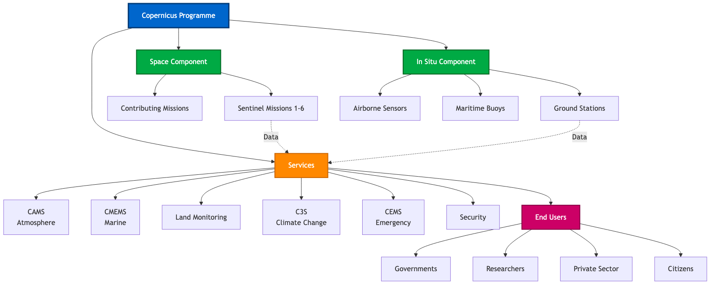
Copernicus Programme Architecture
Copernicus Programme Structure showing Space Component, Services, and End Users
Notes:
This diagram shows the complete Copernicus architecture: the space component with Sentinel missions, in-situ data sources, the six core services (CAMS, CMEMS, Land, Climate, Emergency, Security), and the various end-user categories.

Slide 12
The Sentinel Family
Sentinel-1 (SAR)
C-band radar imaging
All-weather, day/night
1A operational, 1C launched Dec 2024
6-day repeat (dual constellation)
Sentinel-2 (Optical)
Multispectral imaging
13 spectral bands
2A, 2B, 2C operational Jan 2025
5-day repeat (three satellites)
Sentinel-3 (Ocean/Land)
Ocean and land monitoring
Sea surface temperature
Ocean color, vegetation
Sentinel-5P (Atmosphere)
Air quality monitoring
Atmospheric composition
Notes:
Timing: 4 minutes
Key Points: - Six Sentinel missions operational (1, 2, 3, 5P, 6) with 4, 7-12 planned - 2025 Update: Sentinel-1C launched December 2024, restoring 6-day global repeat - 2025 Update: Sentinel-2C operational January 2025, creating 3-satellite constellation with 5-day repeat - Today we focus on Sentinel-1 and Sentinel-2 - most relevant for Philippine DRR/CCA/NRM - Sentinel-3 important for marine/coastal applications - Sentinel-5P monitors air pollution (useful for Manila air quality)
Transition: “These missions generate petabytes of free data. Let’s see how this data is used…”

Slide 13
Copernicus Applications

Slide 14
Emergency Management
Flood mapping
Fire detection
Disaster response
Climate & Environment
Deforestation monitoring
Agricultural monitoring
Water quality assessment
Notes:
Copernicus supports applications in emergency management, health care, agriculture, and environment, with crucial impact on society, climate, and economy.

Slide 15
Sentinel-1: SAR Mission

Slide 16
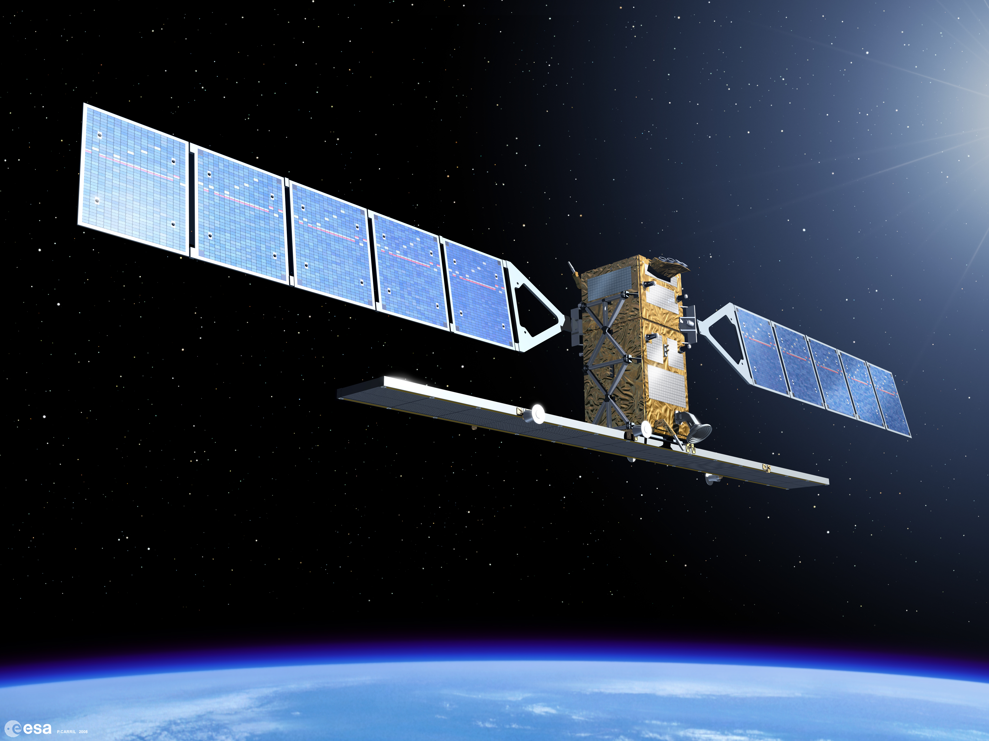
Sentinel-1 Overview
Mission Configuration (2025)
Sensor: C-band Synthetic Aperture Radar
Satellites: 1A, 1C (operational 2025)
Orbit: Polar sun-synchronous
All-weather, day/night capability

Slide 17
Key Advantage: Penetrates clouds and works at night
Notes:
Sentinel-1 is a radar imaging mission with C-band SAR enabling all-weather, day-and-night observations unaffected by clouds - crucial in tropical regions like the Philippines.

Slide 18
Sentinel-1 Technical Specifications
Parameter | Value
Sensor Type | C-band SAR (5.405 GHz)
Revisit Time | 6-12 days (constellation)
Swath Width | 250 km (IW mode)
Spatial Resolution | 5m × 20m (IW mode)
Polarization | VV + VH or HH + HV
Orbit | 693 km altitude
Notes:
Sentinel-1 operates in Interferometric Wide (IW) mode with ~5m by 20m spatial resolution. With two satellites, the revisit cycle is 6 days globally. Note: Sentinel-1B became inoperative in 2022; Sentinel-1C launched in 2024 to restore 6-day revisit.

Slide 19
SAR: How It Works

Slide 20
Satellite sends microwave pulses to Earth
Signal reflects from surface
Sensor measures backscatter intensity
Different surfaces = different backscatter
Notes:
SAR satellites send microwave signals and measure the backscatter. Water appears dark (low backscatter), urban areas appear bright (strong backscatter), and vegetation shows moderate backscatter.

Slide 21
Sentinel-1 Polarization
What is Polarization?
Orientation of radar wave
VV: Vertical send/receive
VH: Vertical send/Horizontal receive
HH: Horizontal send/receive
Applications
VV: Good for water/flood mapping
VH: Sensitive to volume scattering (vegetation)
VV/VH Ratio: Discriminates surface types

Slide 22
Notes:
Sentinel-1 IW mode over land typically provides VV and VH polarizations. Different polarizations are sensitive to different surface characteristics.

Slide 23
Backscatter Characteristics by Target
Surface Type | Backscatter | Appearance | Reason
Water (smooth) | Very Low | Dark/Black | Specular reflection
Urban/Buildings | Very High | Bright White | Corner reflectors
Forest/Vegetation | Medium-High | Gray | Volume scattering
Agricultural Fields | Medium | Light Gray | Surface roughness
Bare Soil (dry) | Low-Medium | Dark Gray | Smooth surface
Bare Soil (wet) | Medium | Medium Gray | Increased dielectric

Slide 24
Key Insight: Water appears dark, structures appear bright - the basis for flood mapping!
Notes:
Understanding backscatter is crucial for interpreting SAR imagery. Smooth surfaces (water) reflect signals away = dark. Rough surfaces and structures reflect signals back = bright.

Slide 25
Sentinel-1 Imaging Modes
Interferometric Wide Swath (IW) - 250 km swath - 5m × 20m resolution - Default over land - Philippine standard mode
Extra Wide Swath (EW) - 400 km swath - 20m × 40m resolution - Maritime/polar regions
Strip Map (SM) - 80 km swath - 5m × 5m resolution - Emergency response - High detail needed
Wave (WV) - Ocean waves - Not used for land
Notes:
Interferometric Wide (IW) mode is used over land and provides the best balance of resolution and coverage. All Philippine acquisitions use IW mode.

Slide 26
Sentinel-1 Data Products
Level-1 GRD (Ground Range Detected)
Multi-looked (reduced speckle)
Projected to ground range
Most commonly used
Faster to process
Smaller file size
Applications:
Change detection
Classification
Flood mapping
Ship detection
Level-1 SLC (Single Look Complex)
Preserves phase information
Complex-valued pixels
Required for InSAR
Larger files
Applications:
Ground deformation
Interferometry
Coherence analysis
Subsidence monitoring
Notes:
For most applications including flood mapping and land cover, GRD products are sufficient. SLC products are needed for advanced interferometric applications like volcano monitoring.

Slide 27
GRD vs SLC - Which to Choose?
Factor | GRD | SLC
Use Case | Most applications | Interferometry only
Processing | Ready to use | Complex processing
File Size | ~1 GB | ~4 GB
Speckle | Reduced | Full speckle
Phase | Not preserved | Preserved
Typical User | Most analysts | Advanced specialists

Slide 28
For this training and most Philippine applications: Use GRD
Notes:
Unless you specifically need interferometry (earthquake/volcano deformation), always use GRD products. They’re easier to work with and sufficient for 90% of applications.

Slide 29
Sentinel-1 Pre-Processing “Under the Hood”
What Happens Before You See SAR Data?
For this training, we use pre-processed Sentinel-1 GRD data. Here’s what happens “under the hood”:
S1 Processing Pipeline:
GRD Download → Raw ground-range detected amplitude
Radiometric Calibration → Convert to backscatter coefficient (σ⁰)
Terrain Correction (RTC) → Remove topographic distortions using DEM
Speckle Filtering → Reduce SAR noise (Lee, Refined Lee, or Gamma-MAP filters)
Conversion to dB → γ⁰ (gamma-naught) in decibels for visual interpretation
Tiling/Clipping → Extract area of interest
For Day 3 flood mapping labs: We provide analysis-ready patches with these steps already applied
Notes:
P0 IMPROVEMENT APPLIED: Explicit S1 pre-processing assumptions before U-Net flood lab (Day 3).
Key Teaching Points: - Participants need to understand what “analysis-ready” means - RTC removes terrain effects - critical in mountainous Philippines - Gamma-naught (γ⁰) in dB is standard for land applications - Speckle filtering is essential but can blur edges - These steps are computationally intensive - we pre-process for efficiency
Timing: 3 minutes
Transition: “Now let’s look at Sentinel-2 optical data…”

Slide 30
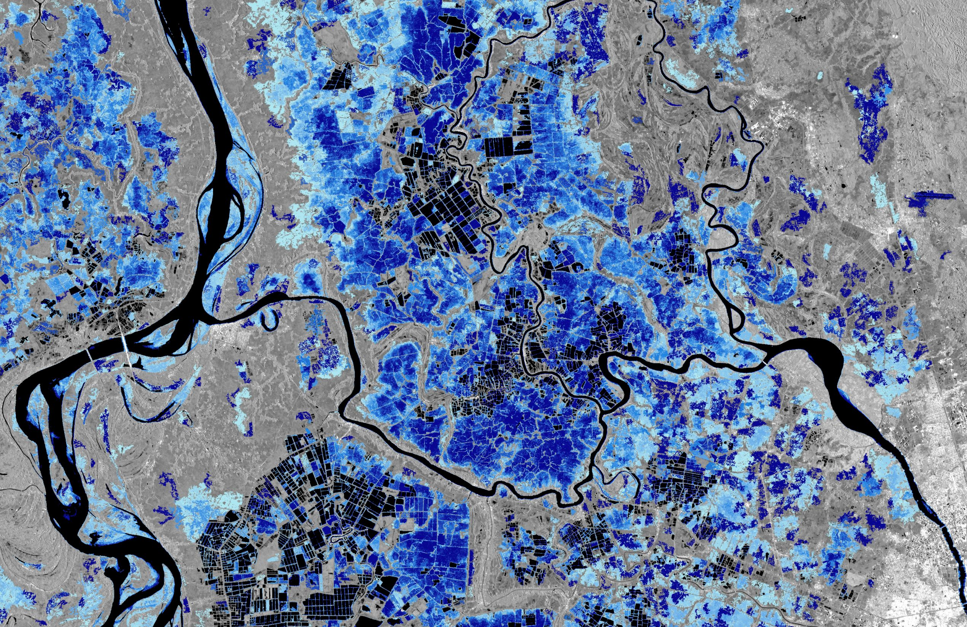
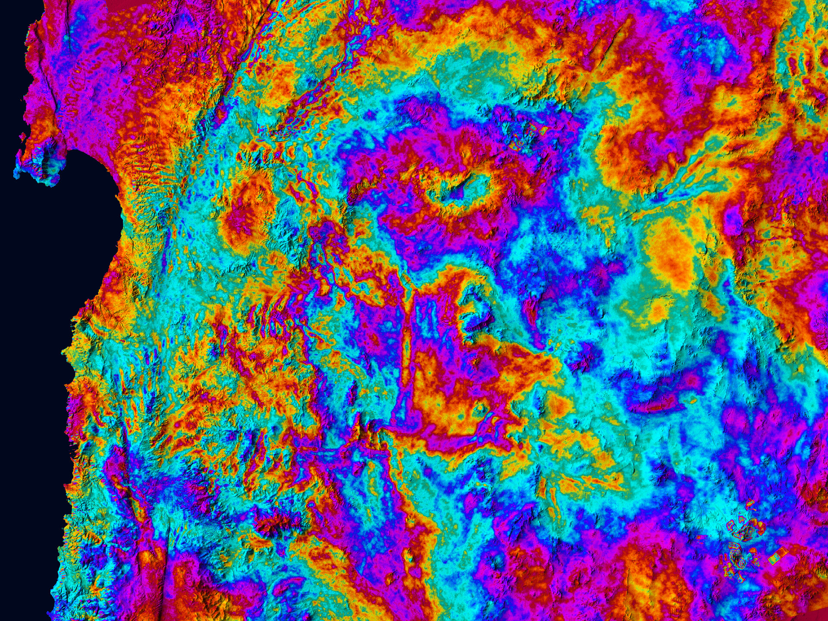
Sentinel-1 Applications
Flood Mapping
Deformation Monitoring
Water appears dark in SAR
Works through clouds
Near real-time monitoring
InSAR technique
Millimeter precision
Volcano and earthquake monitoring
Copernicus Sentinel-1 Flood Monitoring
Sentinel-1C Interferogram of Northern Chile
Notes:
Sentinel-1’s ability to penetrate clouds makes it invaluable for flood mapping during typhoons. The left image shows actual flood monitoring using Sentinel-1 data. The right image shows an interferogram from Sentinel-1C demonstrating ground deformation detection with millimeter precision in northern Chile.

Slide 31
Philippine Example: Flood Monitoring

Slide 32
November 2020: Typhoon Ulysses
Extensive flooding in Luzon
Sentinel-1 detected flood extent
Rapid mapping capability
Key Benefits
No cloud interference
Quick response time
Used for rapid damage assessment
Supported emergency response
Notes:
During Typhoon Ulysses, Sentinel-1 provided crucial flood extent mapping when optical satellites couldn’t see through clouds. This data supported PAGASA and NDRRMC response efforts.

Slide 33
Sentinel-2: Optical Mission

Slide 34
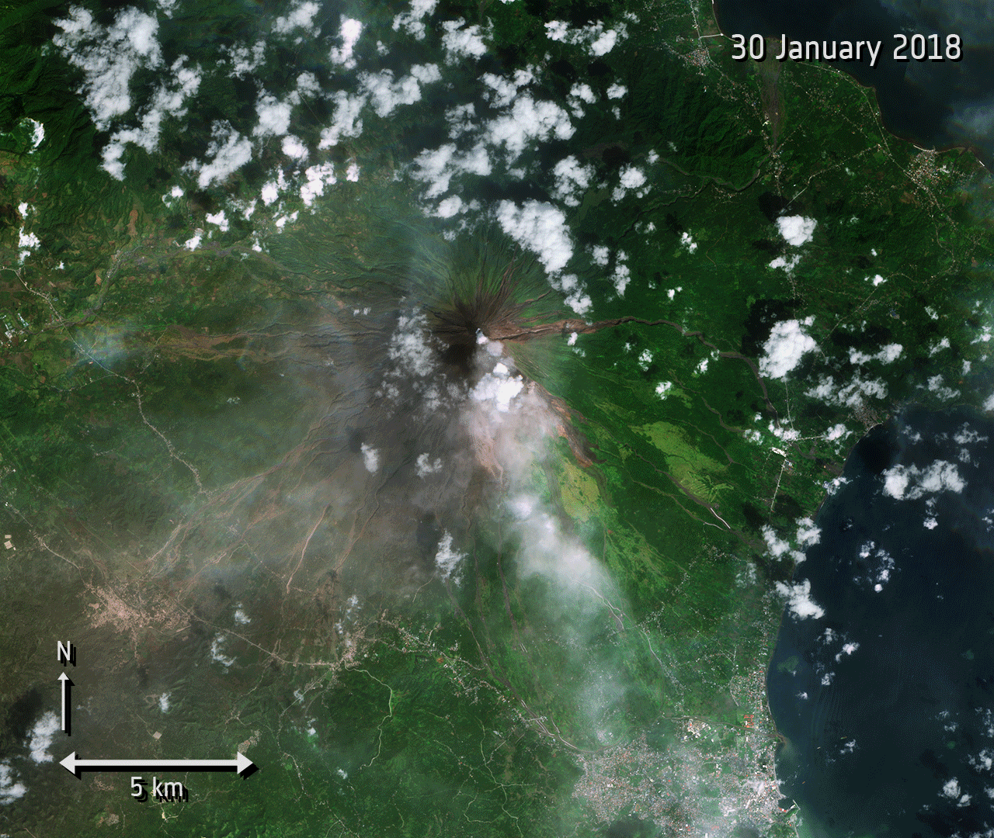
Sentinel-2 Overview
Key Specifications:
13 spectral bands (visible, NIR, SWIR)
10m to 60m spatial resolution
290 km swath width
5-day revisit (three satellites operational 2025)
L1C & L2A processing levels
Philippine Example: Mayon Volcano
Sentinel-2 monitoring of 2018 eruption
False-color composite highlighting lava flows
10m resolution captures detail
5-day revisit enables continuous monitoring
Notes:
This Sentinel-2 false-color image of Mayon Volcano from 2018 shows recent lava flows. With Sentinel-2C operational in 2025, the three-satellite constellation provides 5-day global revisit.

Slide 35
Sentinel-2 Spectral Bands
Notes:
All 13 Sentinel-2 bands: Four 10m bands (B2-B4, B8) for detailed mapping, six 20m bands including the unique Red Edge trio (B5-B7) for vegetation analysis, and three 60m atmospheric bands (B1, B9, B10) for corrections. The Red Edge bands are Sentinel-2’s signature capability.

Slide 36
Red Edge Bands - Sentinel-2’s Special Capability
What is Red Edge?
Transition zone between red and NIR (700-780nm)
Three dedicated bands (B5, B6, B7)
Sensitive to chlorophyll content
Unique to Sentinel-2 among free satellites
Applications:
Early vegetation stress detection
Crop health monitoring
Forest disease identification
Pre-harvest yield estimation
Philippine Use Cases:
Rice crop assessment - Monitor crop health and nitrogen status during panicle initiation in Nueva Ecija rice paddies
Coconut disease detection - Identify stem bleeding disease and pest infestations through spectral signatures
Mangrove health monitoring - Track vegetation stress and recovery in Palawan mangrove forests using red edge indices
Red edge bands detect stress weeks before visible bands show changes
Notes:
Red Edge bands are Sentinel-2’s superpower. They detect vegetation stress weeks before visible bands show changes - crucial for precision agriculture and forest health monitoring.

Slide 37
Sentinel-2 Data Products
Level-1C (L1C)
Top-of-Atmosphere reflectance
Radiometrically corrected
Geometrically refined
No atmospheric correction
Use: If you need raw data for custom processing
Level-2A (L2A)
Bottom-of-Atmosphere (surface) reflectance
Atmospherically corrected
Analysis-ready
Scene Classification Layer included
Use: For most applications - RECOMMENDED

Slide 38
Always use Level-2A when available - it’s analysis-ready!
Notes:
L2A data is atmospherically corrected and ready for analysis. Unless you have a specific reason to use L1C, always choose L2A products.

Slide 39
Sentinel-2 Band Combinations
True Color (Natural) - RGB: B4-B3-B2 (Red-Green-Blue) - Looks like a photograph - Good for visual inspection
False Color Infrared - RGB: B8-B4-B3 (NIR-Red-Green) - Vegetation appears RED - Classic for vegetation assessment
SWIR Composite (Agriculture) - RGB: B11-B8-B2 - Highlights crop moisture - Soil moisture visible
SWIR-NIR-Red (Burn/Fire) - RGB: B12-B8-B4 - Active fires appear BRIGHT - Burn scars dark purple
Notes:
Different band combinations highlight different features. False Color (NIR-Red-Green) is the most common for vegetation mapping - healthy vegetation appears bright red.

Slide 40
Sentinel-1 vs Sentinel-2

Slide 41
Complementary Capabilities
Aspect | Sentinel-1 | Sentinel-2
Sensor Type | Radar (SAR) | Optical (MSI)
Weather | All-weather | Cloud-affected
Time | Day & night | Daytime only
Resolution | 5m × 20m | 10m / 20m / 60m
Revisit | 6-12 days | 5 days
Bands | Polarizations (2) | Spectral bands (13)
Best For | Water, structure, moisture | Vegetation, land cover, color

Slide 42
S1 Flood Mapping Tip
VV polarization shows dark water (low backscatter from smooth surfaces)
Best practice: Compare pre-event vs post-event delta for reliability
Synergy: Pair S1 (flood extent through clouds) with S2 (vegetation damage when clear) for complete impact assessment
Notes:
Sentinel-1 and Sentinel-2 are complementary. SAR penetrates clouds and works at night, while optical provides rich spectral information about surface properties.
MICRO-EDIT APPLIED: Added S1 vs S2 flood tip to set up Day 3 logic - VV dark water, pre/post comparison, and S1+S2 synergy.

Slide 43
Synergistic Use Cases
Flood Mapping
S1: Detect water extent (through clouds)
S2: Assess damage to vegetation/crops (when clear)
Combined: Complete flood impact assessment
Forest Monitoring
S1: Detect structural changes, biomass
S2: Identify tree species, health
Combined: Comprehensive forest mapping

Slide 44
Notes:
Using both missions together provides more complete information. After a typhoon, S1 maps floods under clouds while S2 assesses vegetation damage where it’s clear.

Slide 45
☕ 5-Minute Break
Stretch Break
Stand up • Grab water • Back in 5 minutes
Notes:
Timing: 5 minutes
Instructor Actions: - Announce break clearly - Mention return time - Leave slides/browser open for questions - Be available for quick questions during break
When Resuming: - Wait 1-2 minutes for everyone to return - Quick recap: “We’ve covered Sentinel-1 SAR and Sentinel-2 optical. Now we’ll explore the Philippine EO ecosystem.”

Slide 46
Data Access Methods

Slide 47
Platform Choices for This Training
Task | Platform | Why | Limitations
Data Prep & Exploration | Google Earth Engine | Petabyte catalog, no download, cloud composites | Export limit 32 MB (tile large areas), no deep learning training
ML Training (RF, shallow) | GEE or Colab | RF works in GEE; small data in Colab | GEE memory limits; Colab free tier quotas
Deep Learning (CNN, U-Net) | Local GPU / Colab Pro | Requires PyTorch/TensorFlow | Colab free = limited GPU time; large models need local resources
Large-Scale Processing | CoPhil Mirror Site / COARE | 400TB local data, HPC resources | Requires account; learning curve for APIs
Quick Viz & Download | Copernicus Browser | Interactive, fast previews | Manual selection; bulk downloads tedious
Which Platform for Which Task?
Understanding where to work is crucial - don’t try to train deep models on GEE or download 100GB in Colab!

Slide 48
Quotas/Pitfalls to know: - GEE: Memory errors with large computations (tile exports!) - Colab Free: GPU disconnects after inactivity; limited sessions/day - CoPhil/Digital Space Campus: Hosts this training’s materials + local data access
Notes:
P1 IMPROVEMENT APPLIED: Explicit platform choices table prevents common mistakes.
Key Teaching Points: - GEE is NOT for training U-Nets or downloading GBs - Colab free tier has GPU quotas - manage expectations - CoPhil infrastructure enables local processing - Choose the right tool for the right job
Timing: 3 minutes
Transition: “Let’s look at these platforms in detail…”

Slide 49
Copernicus Data Space Ecosystem (2025)

Slide 50
New Platform (2023+)
Replaced SciHub
Modern interface
API access
Free registration
Features
Search by location/date
Preview before download
Direct download
Bulk processing

Slide 51
URL: https://dataspace.copernicus.eu
Notes:
The Copernicus Data Space Ecosystem is the new portal replacing the legacy SciHub. All Sentinel data are free and open.

Slide 52
SentiBoard Dashboard (October 2025)

Slide 53
Real-time mission status
Data availability insights
Acquisition plans
Quality metrics
Interactive dashboard
Notes:
SentiBoard is a new feature (October 2025) providing real-time insights into Copernicus Sentinel missions and data availability.

Slide 54

Google Earth Engine
Planetary-Scale Platform
Petabyte-scale data catalog
All Sentinel-1 & Sentinel-2 data
Cloud-based processing
Free for research/education
No download needed!

Slide 55
We’ll use GEE extensively in this training
URL: https://earthengine.google.com
Notes:
Google Earth Engine provides ready access to all Sentinel data with cloud-based processing. We’ll use GEE extensively for data access and preprocessing.

Slide 56
Alternative Data Sources
Alaska Satellite Facility (ASF)
Sentinel-1 specialist
User-friendly interface
Preprocessing tools
https://asf.alaska.edu
AWS Open Data
Sentinel-2 on AWS
Cloud-optimized
Pay for compute only
Programmatic access

Slide 57
Now Available: CoPhil Mirror Site in the Philippines! (Operational 2024-2025)
Notes:
MICRO-EDIT APPLIED: Mirror Site is NOW operational (not “coming soon”).
Multiple platforms provide Sentinel data access. The CoPhil Mirror Site provides local data access in the Philippines for faster downloads - critical for reducing international bandwidth bottlenecks.
Key Point: 400TB capacity, focused on PH scenes, free for government/academia/researchers

Slide 58
Part 2: Philippine EO Ecosystem

Slide 59
Overview of Philippine EO Landscape

Slide 60
PhilSA: Space data and operations
NAMRIA: National mapping and geospatial data
DOST-ASTI: AI and remote sensing R&D
PAGASA: Climate and weather data
Notes:
Beyond European satellites, the Philippines has its own geospatial data platforms and agencies that provide crucial complementary data and support.

Slide 61
Philippine Space Agency (PhilSA)

Slide 62
PhilSA: National Space Agency
Established: August 2019
Mandate:
Central civilian space agency
Promote space data use
Build national capacity
Support DRR, CCA, NRM
Co-chair CoPhil programme

Slide 63
Website: https://philsa.gov.ph
Notes:
PhilSA is the central civilian space agency established in 2019. As co-chair of CoPhil, PhilSA is leading national efforts to leverage Copernicus data.

Slide 64
SIYASAT Data Portal

Slide 65
Purpose (2025)
Secure data archive operational
Visualization system
Data distribution
Maritime & terrestrial monitoring
Data Types
NovaSAR-1 radar imagery
AIS ship tracking data
Processed products
Analysis-ready data
Notes:
Timing: 3 minutes
Key Points: - SIYASAT (Secure Interactive Yield-Assessment & SAR Analytics Tools) is PhilSA’s operational data portal - 2025 Status: Fully operational with NovaSAR-1 data access - Provides secure archive for Philippine government agencies - Critical for maritime security (illegal fishing, territorial monitoring) - Registration required - priority for government agencies
Transition: “Beyond PhilSA, DOST-ASTI is leading AI innovation for EO applications…”

Slide 66
Space+ Data Dashboard

Slide 67
User-friendly web portal
Browse satellite imagery
Visualization tools
Download datasets
No programming required
Open to government, researchers, public
Notes:
The Space+ Data Dashboard democratizes access to satellite data, making it available to local governments, researchers, and even students without requiring programming skills.

Slide 68
PhilSA 2025 Initiatives
Space Business Innovation Challenge
Empowers Filipino innovators
Free satellite data access
Build solutions for local needs
Earth observation focus
Weather & environmental data
Training Programs
Downstream data utilization
Practical applications
Capacity building nationwide
Partnership with DOST
Notes:
PhilSA’s 2025 initiatives focus on empowering innovators and building capacity across the Philippines to use satellite data effectively.

Slide 69

COARE Infrastructure
Computing and Archiving Research Environment
High-performance computing
Data archiving capabilities
Science cloud facilities
Supports data-intensive research
Enables AI/ML workflows
Notes:
COARE provides the computational infrastructure needed for processing large satellite datasets and running AI/ML models at scale.

Slide 70
NAMRIA

Slide 71

NAMRIA: National Mapping Authority
National Mapping and Resource Information Authority
Role:
Official mapping agency
Authoritative geospatial data
Topographic maps
Hazard maps
Land cover datasets

Slide 72
Website: https://www.geoportal.gov.ph
Notes:
NAMRIA is the national mapping agency responsible for topographic maps, hydrographic data, and authoritative geospatial datasets.

Slide 73
NAMRIA Geoportal

Slide 74
One-Stop Shop for Philippine Geospatial Data
National basemaps (1:50,000 scale)
Administrative boundaries
Topographic maps
Thematic maps
Downloadable shapefiles and rasters
Notes:
The NAMRIA Geoportal is the go-to source for official Philippine spatial data including boundaries, topographic maps, and land cover data.

Slide 75
Land Cover Mapping Project

Slide 76
Latest: 2020 National Land Cover
Classes:
Forest types
Agriculture
Built-up areas
Water bodies
Wetlands
Barren land
Data Formats:
Shapefile
GeoTIFF
CSV
GeoJSON
KML
PNG

Slide 77
Portal: https://land-cover-mapping-project-namria.hub.arcgis.com
Notes:
NAMRIA’s land cover datasets are valuable for validation and comparison with satellite-derived classifications. The 2020 national land cover map is available in multiple formats.

Slide 78
HazardHunterPH Portal

Slide 79
Comprehensive Hazard Assessment Platform

Slide 80
Hazard Types:
Earthquake-induced hazards
Active fault lines
Tsunami susceptibility
Liquefaction zones
Landslide hazards
Applications:
Disaster risk assessment
Land use planning
Infrastructure siting
Emergency preparedness

Slide 81
URL: https://hazardhunter.georisk.gov.ph/map
Notes:
HazardHunterPH provides critical hazard data for DRR planning. These maps can be overlaid with satellite data for vulnerability assessments.

Slide 82
How NAMRIA Complements Sentinel Data
Sentinel Imagery Provides:
Current conditions
Frequent updates
Large-area coverage
Multi-temporal analysis
NAMRIA Data Provides:
Ground truth for validation
Training labels for ML models
Historical baselines
Official classifications
Hazard context

Slide 83
MICRO-EDIT: Using NAMRIA/Space+ as Label Sources
For Day 2 Palawan RF lab: 1. Download NAMRIA land cover shapefile (authoritative classes) 2. Overlay on Sentinel-2 imagery 3. Extract training points per class (forest, agriculture, water, etc.) 4. Train Random Forest classifier 5. Validate predictions against NAMRIA hold-out samples
Space+ Dashboard also provides admin boundaries and infrastructure layers for context in all visualizations.
Example: Use Sentinel-2 to map current land cover, validate against NAMRIA’s official 2020 map, detect changes
Notes:
MICRO-EDIT APPLIED: Explicit link between NAMRIA/Space+ as label sources & validation layers, not just context.
NAMRIA data provides essential ground truth and context for satellite-based analysis. Official boundaries and hazard maps enhance satellite data interpretation.
Show one example overlay: NAMRIA training polygons (land cover classes) overlaid on S2 RGB composite.

Slide 84
DOST-ASTI AI Initiatives

Slide 85

DOST-ASTI Overview
Advanced Science and Technology Institute
Lead agency for EO and AI R&D
Remote sensing expertise
Machine learning development
National AI infrastructure
P2.6 billion investment until 2028

Slide 86
Website: https://asti.dost.gov.ph
Notes:
DOST-ASTI leads several projects at the intersection of remote sensing, AI, and big data, with significant national investment of P2.6 billion through 2028.

Slide 87
DATOS: Remote Sensing Help Desk

Slide 88
Remote Sensing and Data Science Help Desk
Rapid analytics during disasters
Flood mapping from satellite imagery
Damage assessment
Crop mapping (rice, sugarcane)
Road network detection
Supports emergency response agencies
Notes:
During past typhoons, DATOS used satellite images to produce flood maps and give them to disaster response agencies within hours. They also worked on crop mapping and infrastructure detection using AI.

Slide 89
SkAI-Pinas Programme

Slide 90
Philippine Sky AI Program (2021-2028)
Flagship AI R&D programme
Part of P2.6B DOST AI investment
Democratize AI across Philippines
Remote sensing & big data focus
Impact (2025)
300+ institutions supported
Universities & colleges
SMEs & research teams
Local government units
Notes:
Timing: 3 minutes
Key Points: - 2025 Update: SkAI-Pinas is part of DOST’s P2.6 billion AI investment (2024-2028) - Focuses on democratizing AI for EO applications - Provides infrastructure, training, and support - Successfully engaged 300+ institutions nationwide - Critical for building national AI capacity
Examples: - Universities using SkAI for flood mapping research - LGUs leveraging AI for disaster preparedness - SMEs building EO-based agricultural solutions
Transition: “SkAI provides the platform. DIMER provides the models. PANDA brings it all together…”

Slide 91
DIMER: AI Model Hub

Slide 92
Democratized Intelligent Model Exchange Repository
Digital “model store”
Pre-trained AI models
Ready-to-use
Filipino-specific challenges
Available Models
Landslide detection
Traffic surveys
Crop monitoring
Land cover classification
Flood detection
Notes:
DIMER lowers barriers to AI by enabling end-users to reuse optimized AI models. If you need a model for land cover or flood detection, check DIMER first before building from scratch.

Slide 93
AIPI: AI Processing Interface
Purpose
Streamline large-scale remote sensing tasks
Reduce computational barriers
Run AI models on ASTI servers
Process hundreds of images efficiently

Slide 94
Example: Apply an AI model to 100 Sentinel-2 images over entire region without your laptop
Notes:
AIPI allows users to run large computations on ASTI’s servers without heavy local processing. This is especially valuable when processing many satellite images with AI models.

Slide 95
ALaM: Automated Labeling Machine
Challenge
Creating labeled training data is:
Time-consuming
Expensive
Requires expertise
Major bottleneck for AI
ALaM Solution
Automate labeling process
Crowdsourcing capabilities
Expert validation
Build training datasets

Slide 96
Result: Faster creation of high-quality training data for Filipino contexts
Notes:
Creating labeled data is a big challenge in EO AI. ALaM tries to address this through automation and crowdsourcing, making it easier to build training datasets for Philippine applications.

Slide 97
How DOST-ASTI Tools Work Together

Slide 98
ALaM creates training data
Train models and share via DIMER
Process large datasets with AIPI
Deploy for operational use via SkAI-Pinas
Support disaster response through DATOS
Notes:
These initiatives work together to create a complete ecosystem from data labeling through model development to operational deployment.

Slide 99
PAGASA & Other Data Sources

Slide 100
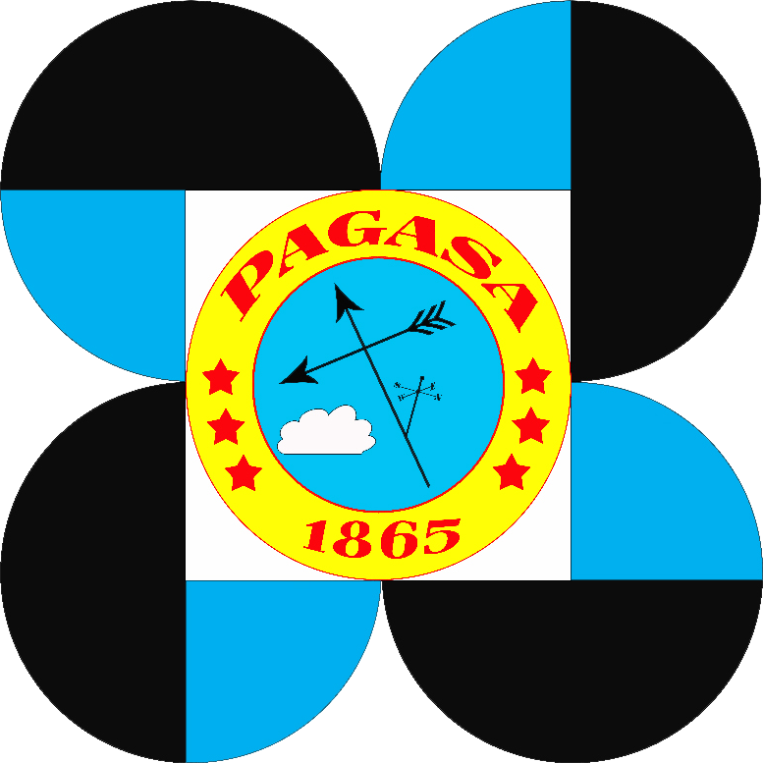
PAGASA: Weather & Climate Data
Philippine Atmospheric, Geophysical and Astronomical Services Administration
Data Types:
Historical rainfall
Temperature records
Typhoon tracks
Climate forecasts
Weather observations

Slide 101
Integration: Combine with satellite data for climate analysis
Notes:
PAGASA provides meteorological and climate data that can be integrated with satellite observations for comprehensive analysis. Rainfall data + flood maps, for example.

Slide 102
Synergy: Satellite + Ground Data
Satellite Data (Sentinel)
Spatial coverage
Consistent acquisition
Multiple variables
Time series
Ground Data (Philippine agencies)
Point validation
Ground truth
Meteorological context
Local expertise

Slide 103
Combined = More robust analysis and higher confidence
Notes:
The Philippines is developing a rich EO ecosystem. The goal of CoPhil is to ensure you can leverage both international (Sentinel) and national data together effectively.

Slide 104
CoPhil Infrastructure

Slide 105
CoPhil Mirror Site

Slide 106
Philippines-based Copernicus data repository
Local mirror of Sentinel data
Focus on Philippine region
Faster access (no international bandwidth)
Reliable availability
Operational by 2025
Hosted by PhilSA with CloudFerro support
Notes:
The CoPhil Mirror Site will locally store Sentinel data focused on the Philippines, enabling much faster downloads than from European servers.

Slide 107
Digital Space Campus

Slide 108
Purpose
Online learning portal
Training materials repository
Self-paced learning
Community of practice
Knowledge sharing
Content
Course presentations
Jupyter notebooks
Datasets
Guides & tutorials
Forum discussions
Notes:
All materials from this 4-day training will be available on the Digital Space Campus for future reference and for colleagues who couldn’t attend.

Slide 109
Building a Sustainable EO Ecosystem
Data Access: Mirror Site + Data Space Ecosystem
Processing: COARE + AIPI + Google Earth Engine
Models: DIMER repository
Training: Digital Space Campus
Operations: DATOS + Agency integration
Community: SkAI-Pinas network
Result: Complete infrastructure for operational EO AI/ML**
Notes:
CoPhil is building sustainable infrastructure ensuring you can continue working with Sentinel data and AI/ML tools after this training, without starting from scratch.

Slide 110
Summary & Integration

Slide 111
Key Takeaways
Copernicus provides free, high-quality satellite data globally
Sentinel-1 (SAR) works day/night, all-weather - essential for tropics
Sentinel-2 (optical) provides rich spectral information - 5 day revisit
Multiple access methods available (Data Space, GEE, Mirror Site)
Philippine agencies provide complementary data and expertise
CoPhil infrastructure supports sustainable capacity building
Notes:
You now understand the full picture from data sources through national infrastructure. This foundation supports all subsequent AI/ML work.

Slide 112
How It All Connects
Notes:
Satellite data + Philippine ground truth + AI models + processing infrastructure = Operational applications for DRR, CCA, and NRM

Slide 113
Example Workflow: Flood Mapping
Acquire Sentinel-1 SAR data (GEE or Mirror Site)
Validate with PAGASA rainfall data
Process using AI model from DIMER
Scale processing via AIPI
Combine with NAMRIA hazard maps
Deliver to NDRRMC via DATOS
This is what integrated EO capacity looks like!
Notes:
A real-world workflow leverages multiple data sources, AI tools, and institutional partnerships. This is exactly what CoPhil aims to enable.

Slide 114
What’s Next in Day 1?
Session 2 (Next)
AI/ML fundamentals
Supervised vs unsupervised learning
Neural networks basics
Data-centric AI
→ 5-min Concept Check (3 questions)
Sessions 3 & 4
Hands-on Python (GeoPandas, Rasterio)
Pre-run pip installs to save time
Google Earth Engine tutorial
Start from ready script, modify filters only
Access real Sentinel data
SCL cloud/shadow masking (not QA60)
Notes:
Now that you understand where data comes from, we’ll learn how AI/ML can extract information from these data, then get hands-on with actual satellite imagery.
P1 IMPROVEMENTS NOTED: - Concept check after Session 2 - Pre-run installations in Session 3 - Ready GEE script in Session 4 (modify filters live, don’t type from scratch)

Slide 115
Session Summary
What We Covered:
✅ Copernicus Programme & free/open data policy ✅ Sentinel-1 (SAR) - all-weather monitoring ✅ Sentinel-2 (Optical) - 13 bands, 10m resolution ✅ 2025 Updates: 1C & 2C operational ✅ Philippine EO infrastructure (PhilSA, NAMRIA, DOST-ASTI) ✅ Data access platforms (SIYASAT, Geoportal, SkAI-Pinas)
Notes:
Timing: 2 minutes
Key Takeaways: - You now understand WHERE EO data comes from - You know WHAT satellites provide what data - You know HOW to access data (both EU and PH platforms) - Ready for Session 2: Learning WHAT to do with this data using AI/ML

Slide 116
Q&A
Copernicus & Sentinel
Mission specifications?
Data products & formats?
Access methods?
Processing levels?
Philippine EO Ecosystem
Agency roles & mandates?
Data access procedures?
Integration with Copernicus?
P2.6B AI investment details?
Notes:
Timing: 3-5 minutes for Q&A
Facilitation Tips: - Encourage questions from different agency participants - Share knowledge across government, academic, private sectors - If technical question about access, note for Session 4 (GEE hands-on) - Keep responses brief - detailed hands-on coming in Sessions 3-4
Common Questions & Answers: - “How do I sign up for GEE?” → Will cover in Session 4 - “Which satellite should I use?” → Depends on application (Day 2 topic) - “Is SIYASAT public?” → Registration required, priority for gov agencies - “Can I combine Sentinel-1 and -2?” → Yes! Synergistic use cases discussed today

Slide 117
Next: Session 2

Slide 118
Core Concepts of AI/ML for Earth Observation
Coming up after break:
What is AI/ML and why for EO?
The EO AI/ML workflow
Supervised vs unsupervised learning
Introduction to deep learning
Data-centric AI approaches
See you in Session 2! 🚀

Slide 119
Thank You!

Slide 120
Contact & Resources
European Platforms: Copernicus Data Space: https://dataspace.copernicus.eu CoPhil Programme: https://www.cophil.eu
Philippine Platforms: PhilSA: https://philsa.gov.ph NAMRIA Geoportal: https://www.geoportal.gov.ph DOST-ASTI: https://asti.dost.gov.ph
Notes:
Session 1 Complete!
Total timing: ~120 minutes including breaks and Q&A
Before Session 2: - Short bio break (5-10 minutes) - Check that all participants are ready - Ensure presentation materials for Session 2 are loaded

Slide 121
15-minute break before Session 2

